Slide 1

Let’s Rescue Children

Slide 2

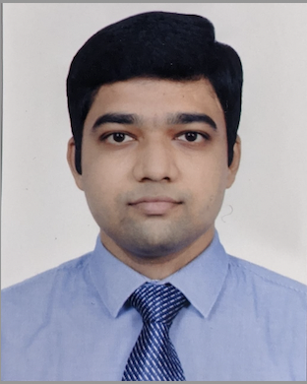
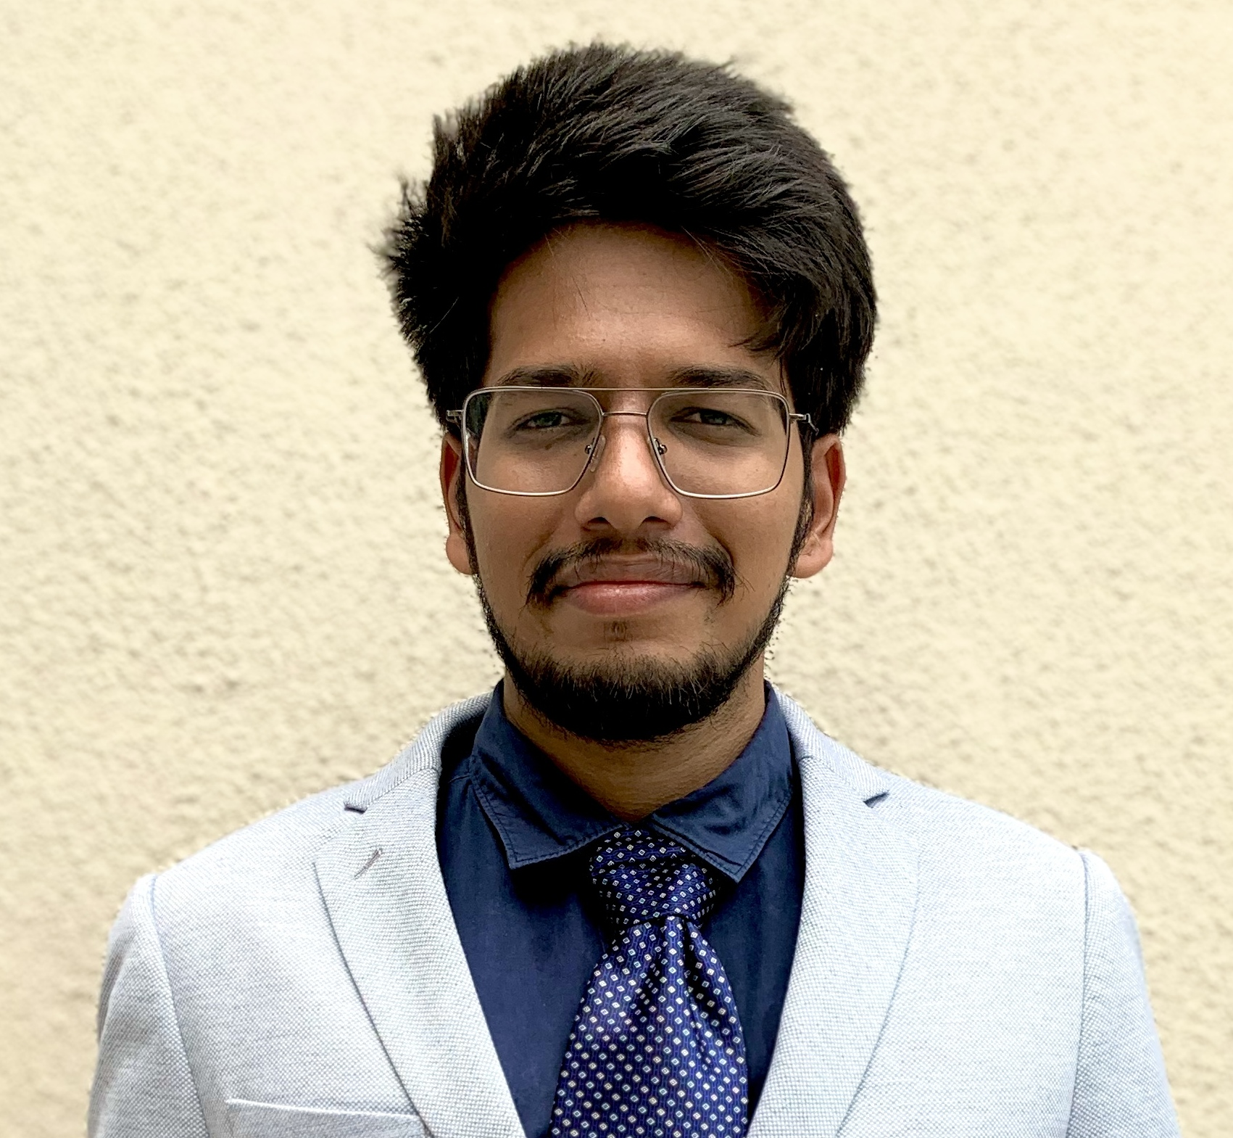
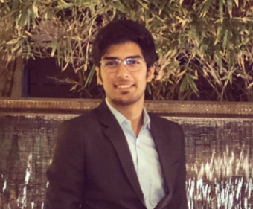
Viraj Shah
Abhishek Bagdare
Dhaval Patel
Programmer
Programmer
Programmer
OUR TEAM

Slide 3
PROBLEM STATEMENT
According to data from Census 2011, the number of child laborers in India is 10.1 million of which 5.6 million are boys and 4.5 million are girls
3 out of Every 7 Children face some form of abuse during their childhood
Many orphans are taken hostages as child labors, No resources or system to fight or rescue and rehabilitate them.
NGOs do not have a centralized system that can help interact with multiple parties to rescue and rehabilitate children who are victims of multiple atrocities.

Slide 4
APPROACH
Design a software system for NGOs that can initiate a restoration process for a child who has been a victim of atrocities through reporting to NGO
A Volunteer from NGO would be assigned to the case, he would then examine the case and redirect the case to the necessary stakeholder.
Children who faced physical abuse would be sent to doctors, mental abuse would be sent to counsellor or psychiatrist depending on their state of need. Incase of any unlawful situation, the case can be sent to a lawyer.
After his treatment , the child would be sent to a rehabilitation home where his safety would be safeguarded.

Slide 5
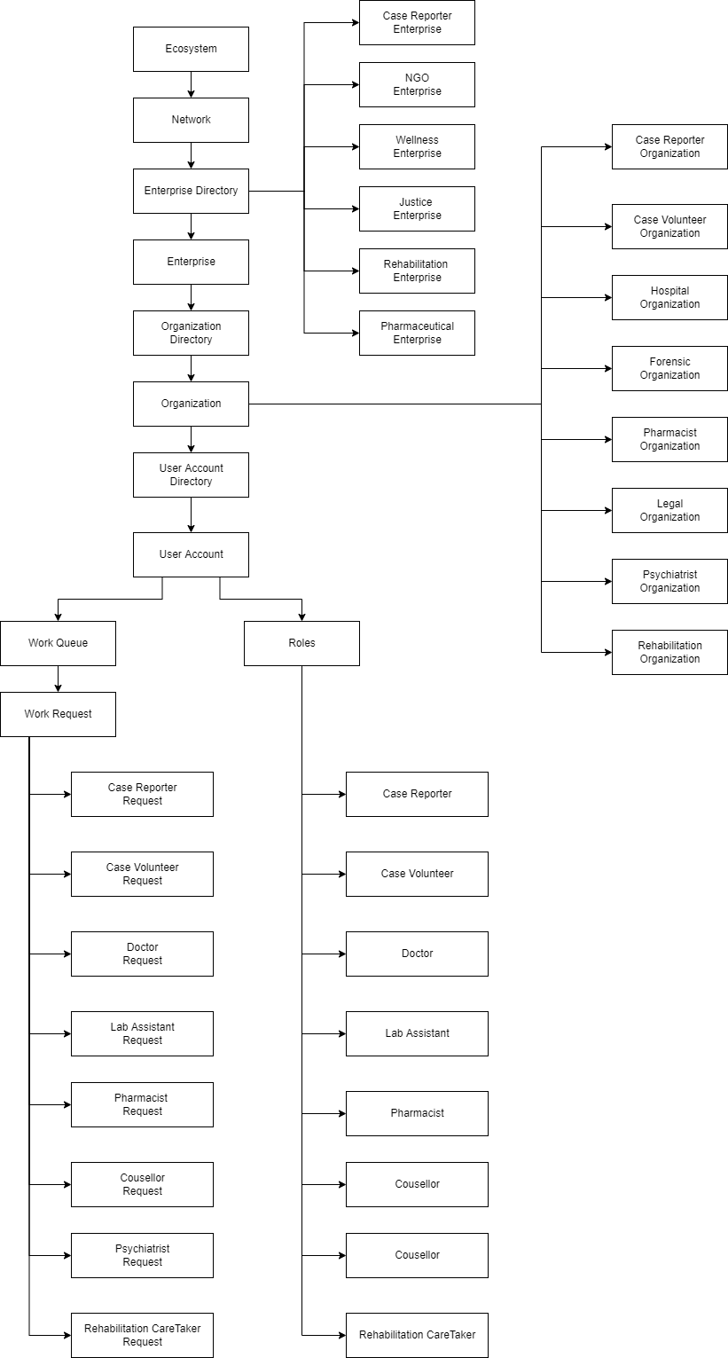
OBJECT MODEL

Slide 6





ENTERPRISES
JUSTICE
WELLNESS
NGO
REHABILITATION
PHARMACY

Slide 7
ENTERPRISES
Pharmacy : Contains Organizations that can provide medicines to the child
NGO : Contains Organizations that can provide Initial response support to the child
Justice : Contains Organizations that can provide Legal support to the child
Wellness : Contains Organizations that can provide Hospital support to the child
Rehabilitation : Contains Organizations that can provide Rehab to the child

Slide 8









ROLES
LAB ASSISTANT
SYSTEM ADMIN
LAWYER
COUNSELLOR
CASE REPORTER
PSYCHIATRIST
PHARMACIST
DOCTOR
CASE VOLUNTEER

Slide 9
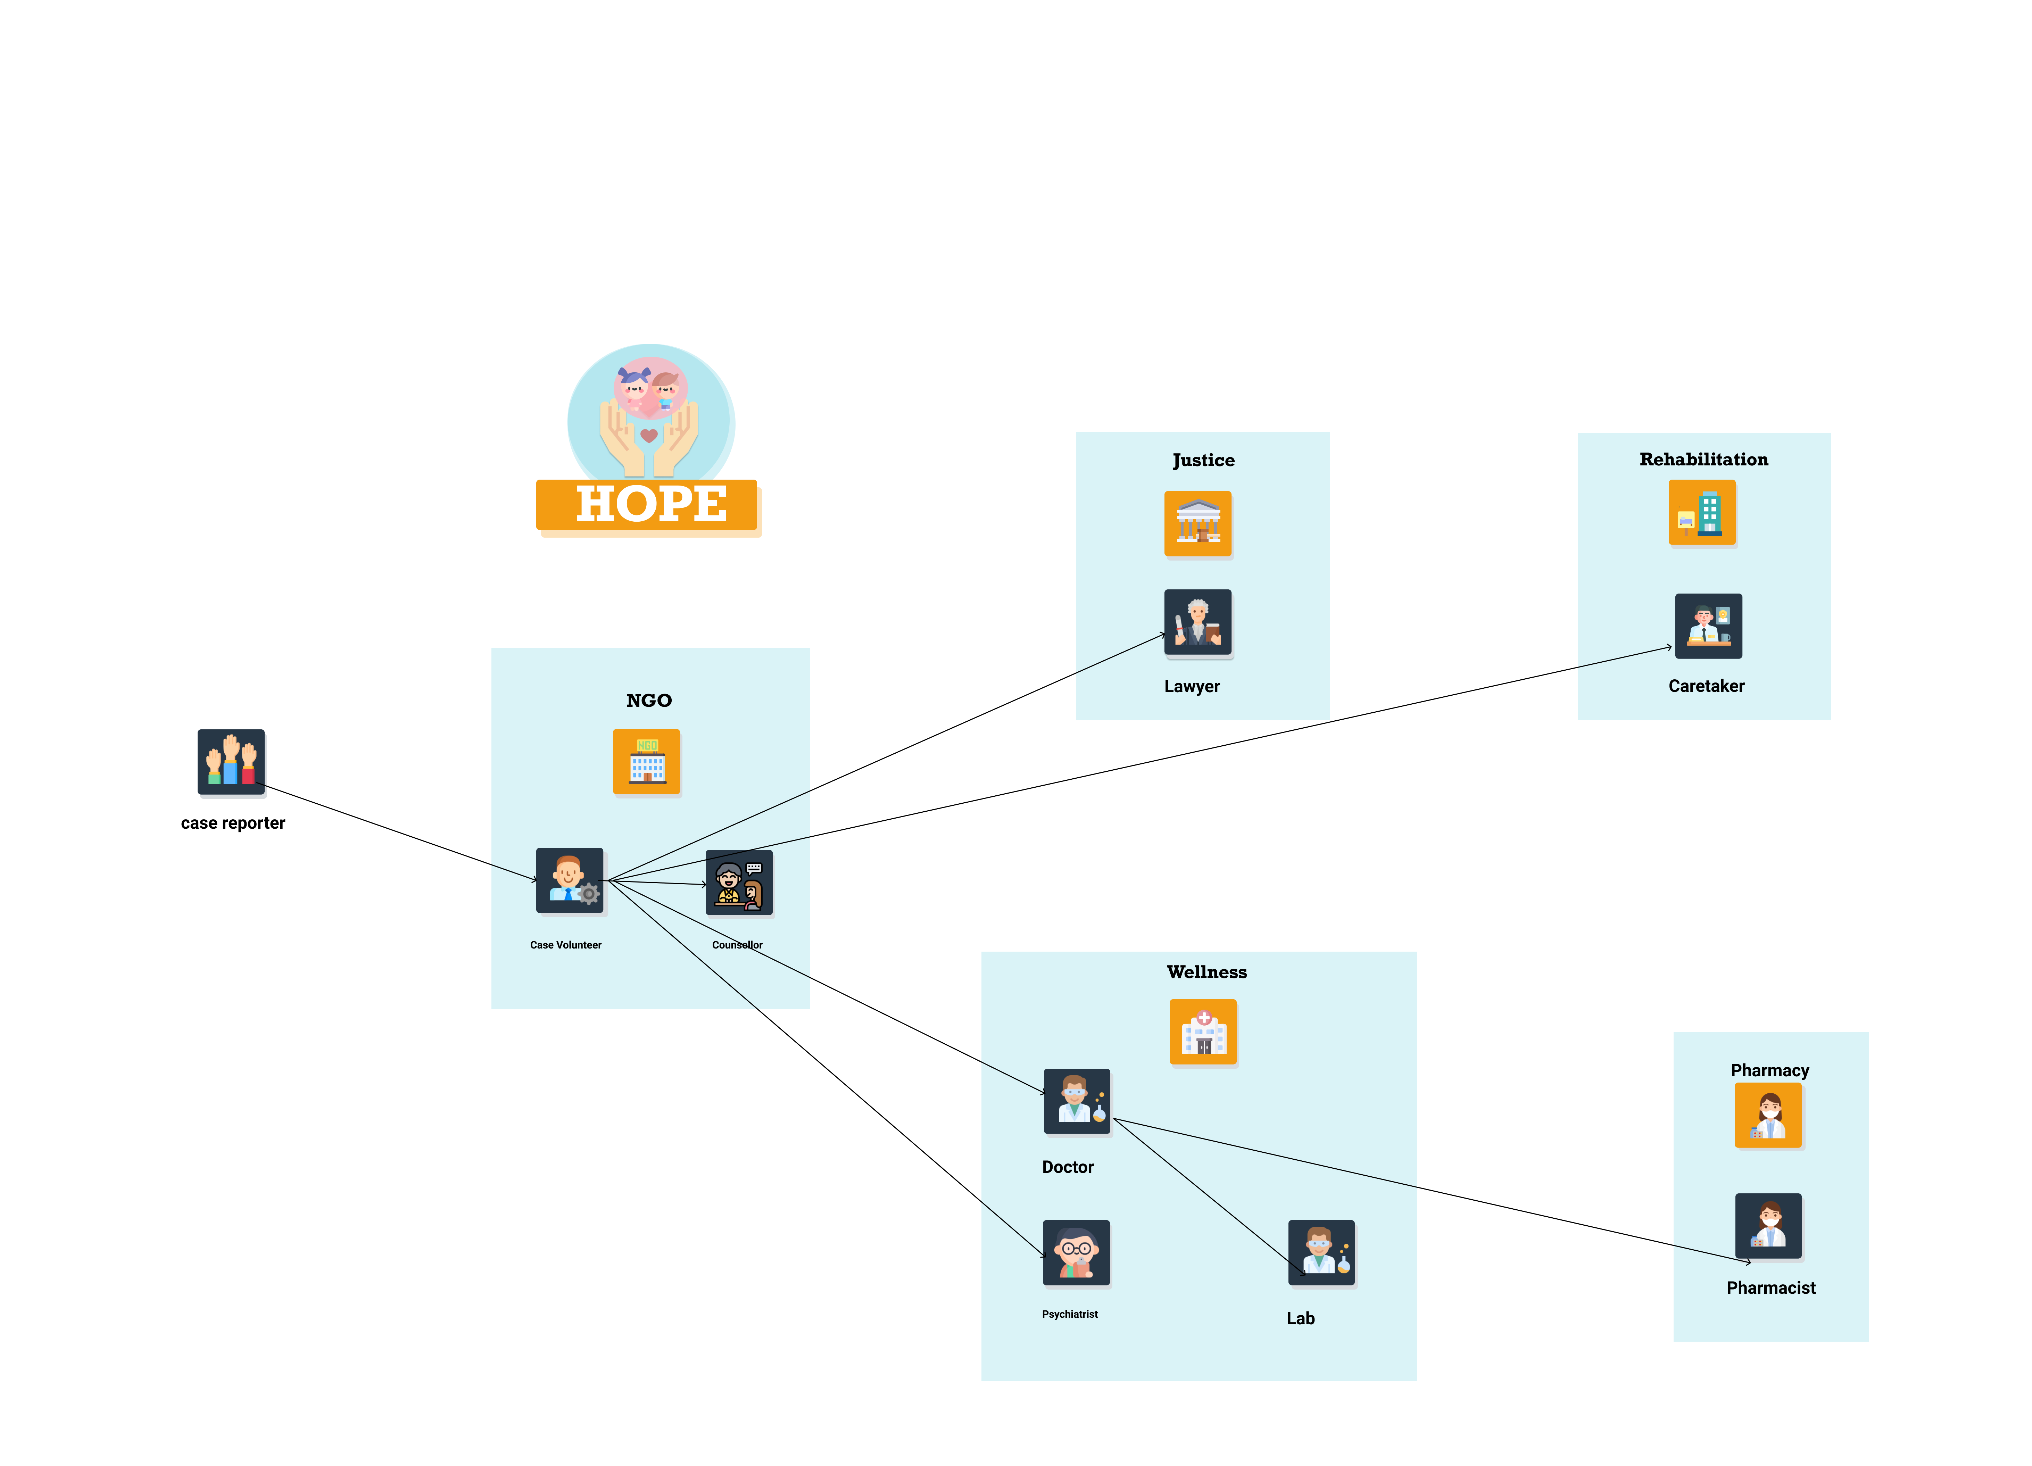
APPLICATION USER FLOW

Slide 10
USE CASES (WORK REQUESTS)
Use Case 1: Case Reporter - Case Volunteer Work Request
Case Reporter registers a report with all the details regarding the assault.
The request is sent to the Case Volunteer who accepts and assigns the case to concerned entities for further proceedings
Use Case 2: Case Volunteer - Doctor Work Request
Case Volunteer reads the report regarding the assault and request is sent to Doctor.
The Doctor accepts a case and sends invite to the patient for appointment

Slide 11
USE CASES (WORK REQUESTS)
Use Case 3: Doctor – Lab Assistant Work Request
Doctor reads the report regarding the assault and request is sent to Lab Assistant for conducting the Lab Tests.
The Lab Assistant accepts a lab test requests and sends results to the doctor
Use Case 4: Doctor - Pharmacy Work Request
Doctor sends the request to Pharmacist after the health check-up.
The Pharmacists views the prescription request and sends invite to patient for pickup
The Doctor can then view the results.

Slide 12
USE CASES (WORK REQUESTS)
Use Case 5: Case Volunteer – Counsellor Work Request
Case Volunteer reads the report regarding the assault and request is sent to Counsellor.
Use Case 6: Case Volunteer – Lawyer Work Request
Case Volunteer reads the report regarding the assault and request is sent to Lawyer.
The Lawyer accepts a case and sends invite to the patient for appointment
The counselor keeps a record of each encounter
The Counselor accepts a case and sends invite to the patient for appointment
The Lawyer keeps a record of each encounter

Slide 13
USE CASES (WORK REQUESTS)
Use Case 7: Case Volunteer – Psychiatrist Work Request
Case Volunteer reads the report regarding the assault and request is sent to Psychiatrist.
The Psychiatrist keeps a track of each encounter and progress
The Psychiatrist accepts a case and sends invite to the patient for appointment.

Slide 14
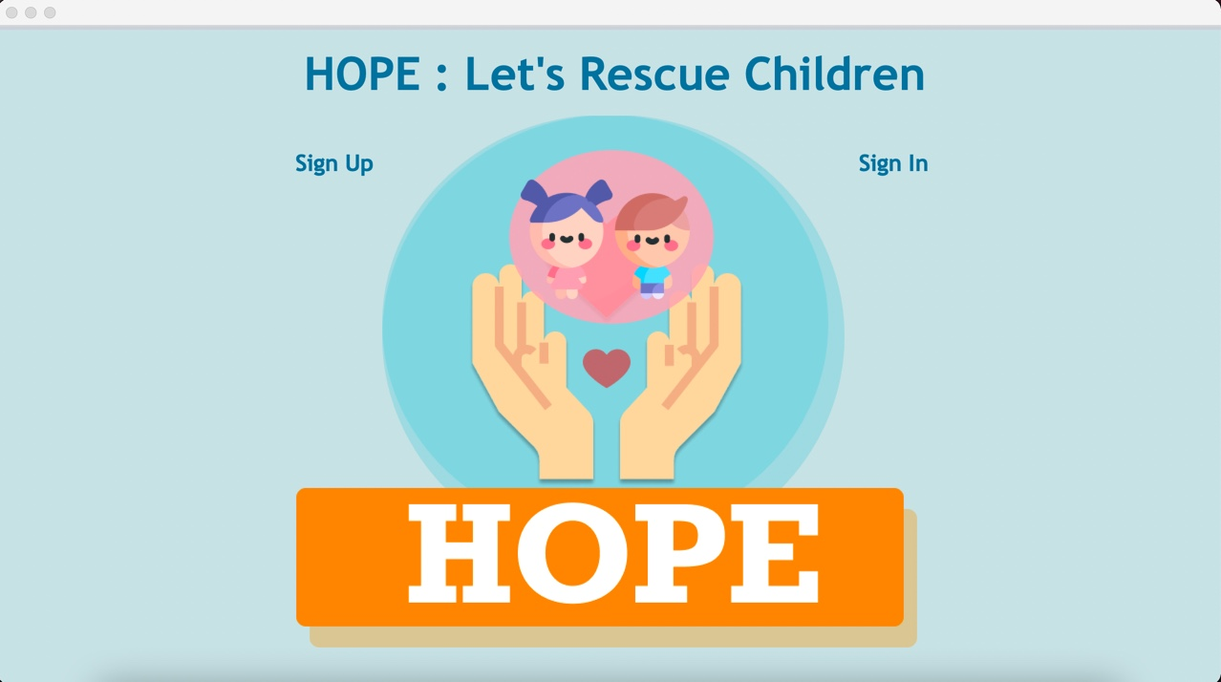
SCREENSHOTS
DASHBOARD

Slide 15
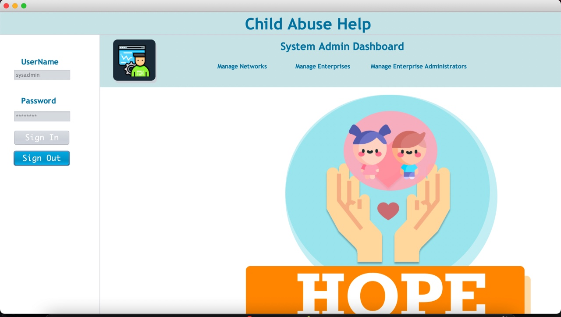
SCREENSHOTS
SYSTEM ADMIN DASHBOARD

Slide 16
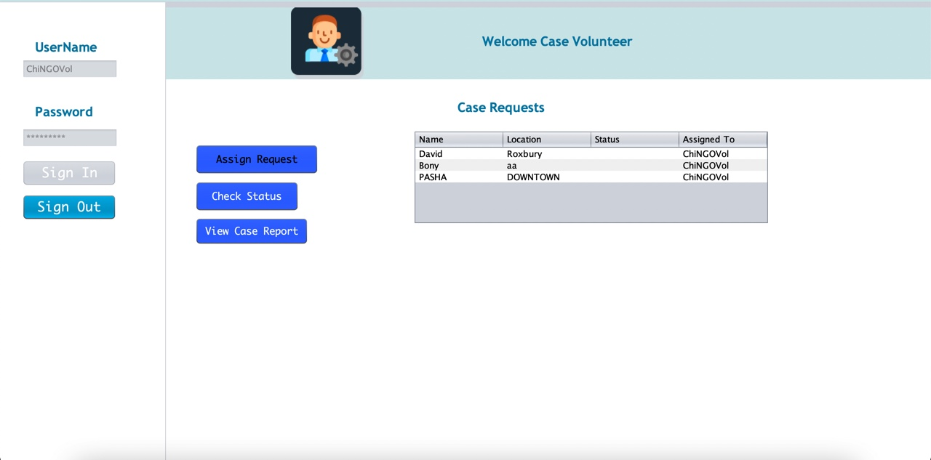
SCREENSHOTS
CASE VOLUNTEER DASHBOARD

Slide 17
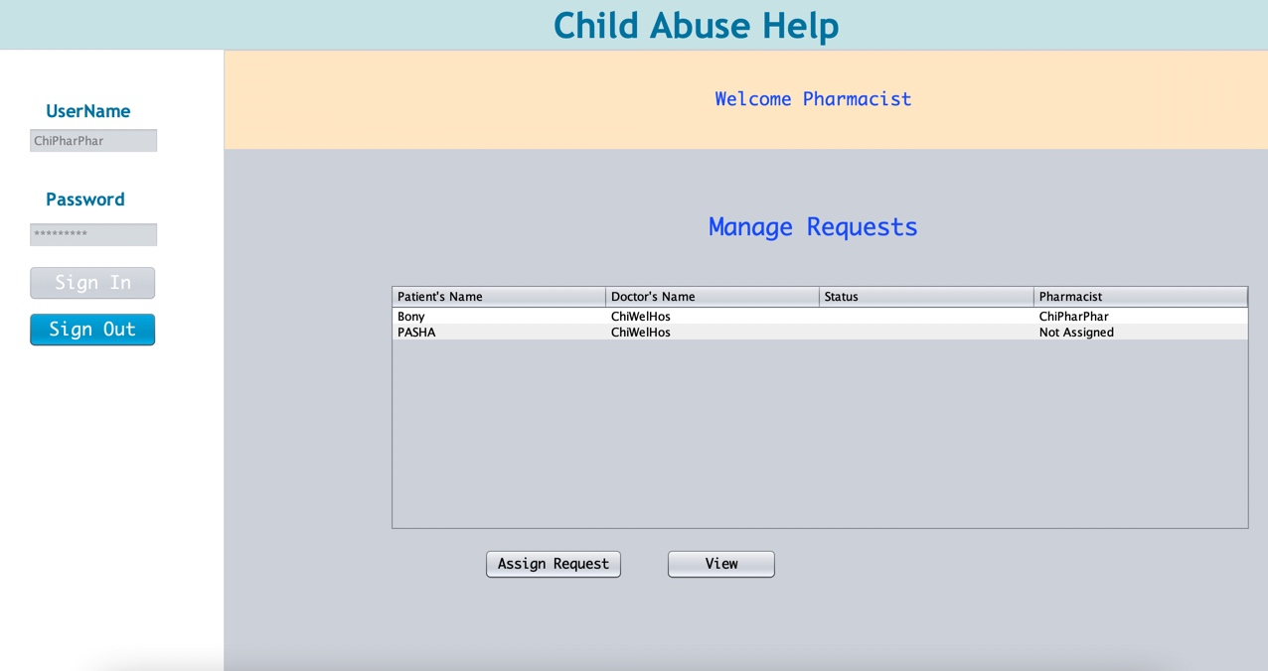
SCREENSHOTS
PHARMACIST DASHBOARD

Slide 18
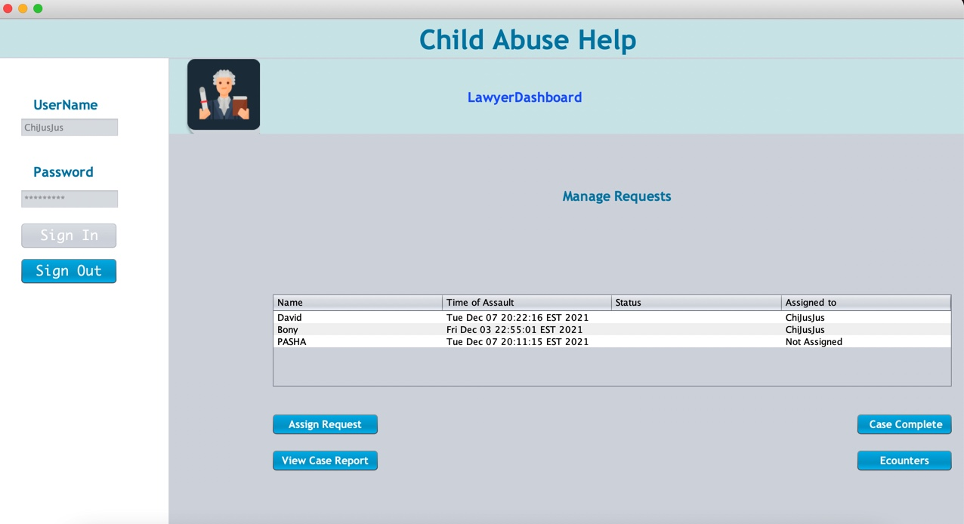
SCREENSHOTS
LAWYER DASHBOARD

Slide 19
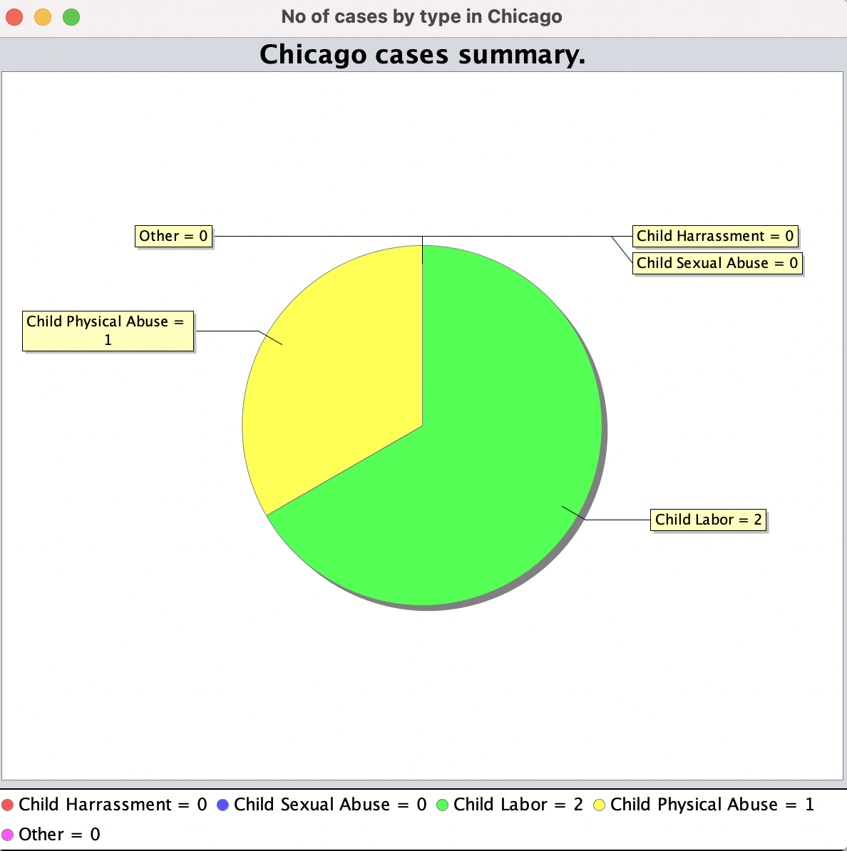
SCREENSHOTS
PIE CHART SUMMARY DASHBOARD

Slide 20
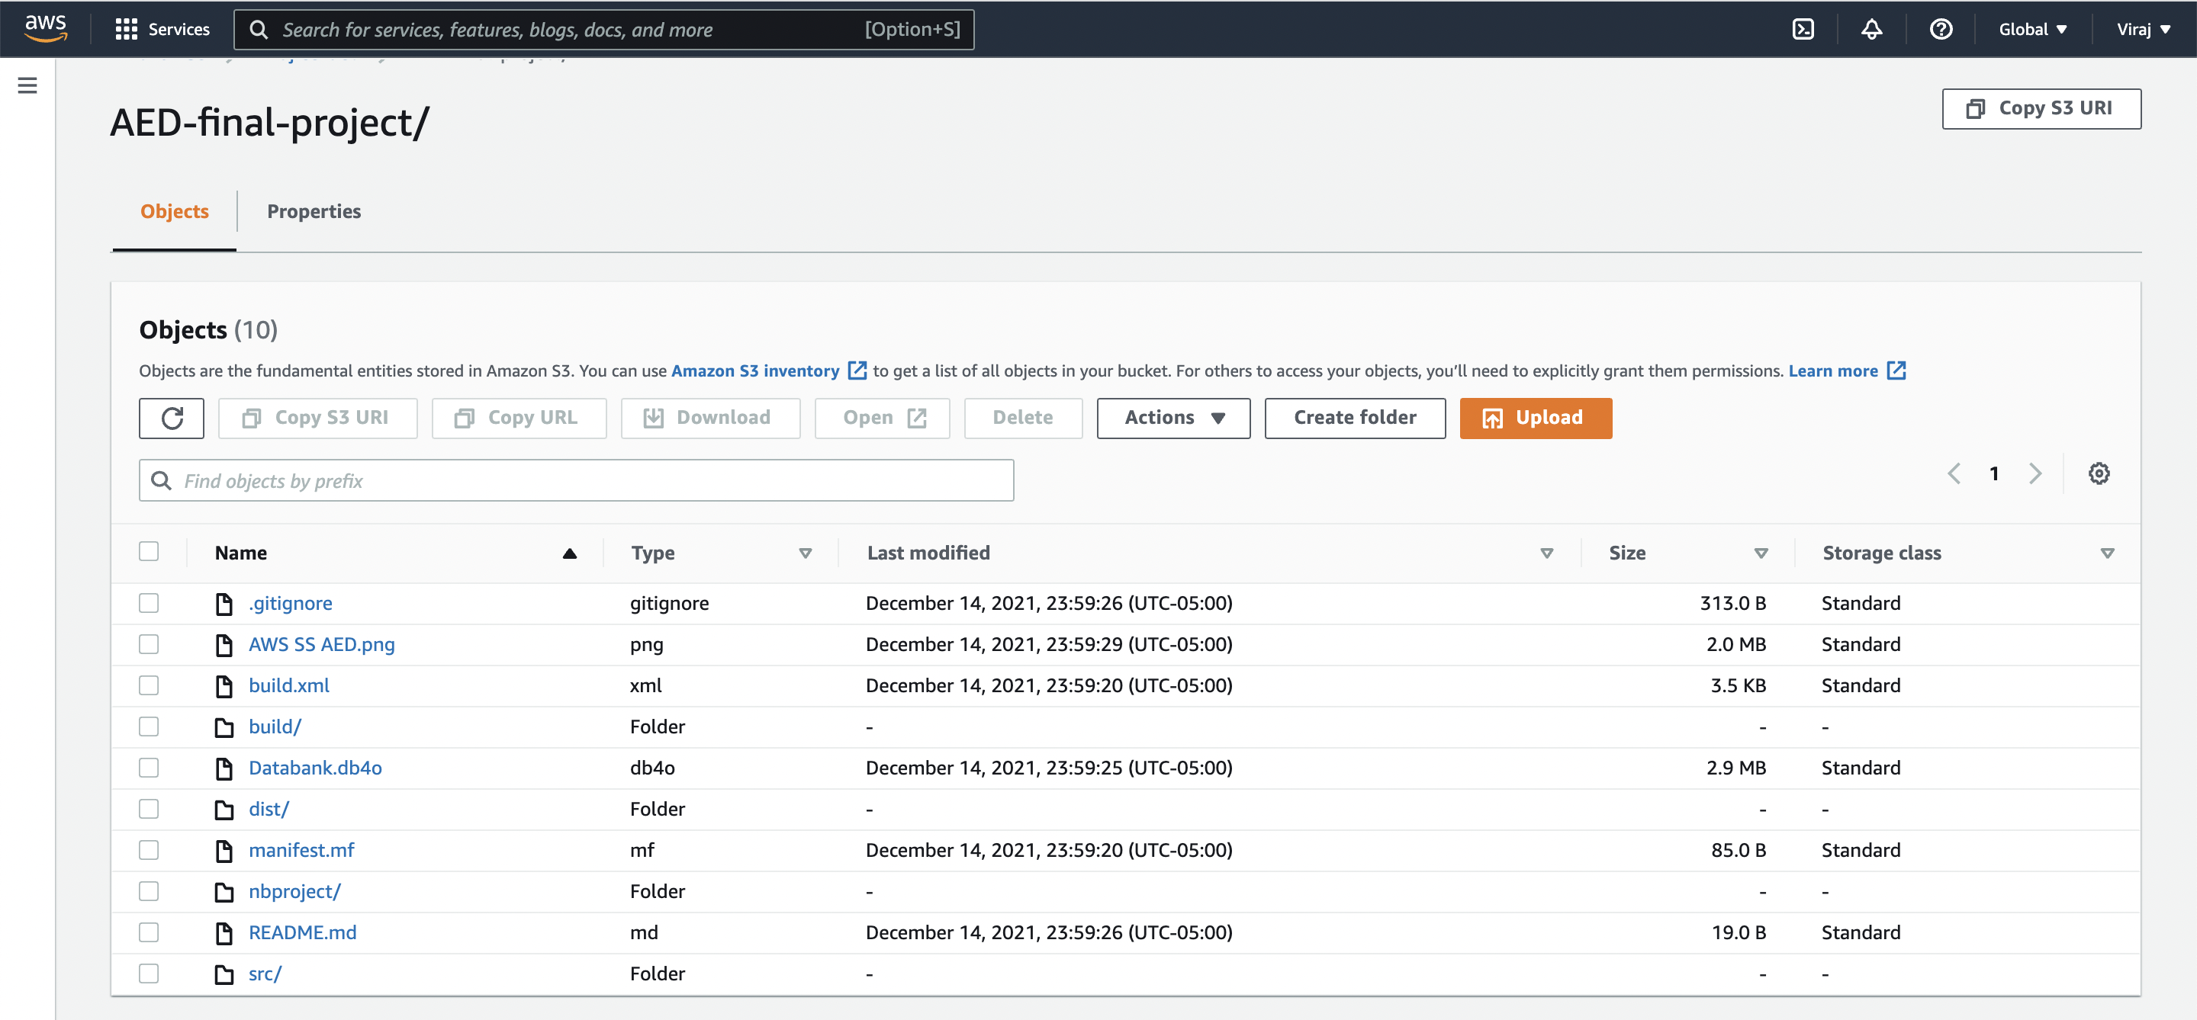
SCREENSHOTS
AWS S3 Bucket for CI/CD

Slide 21
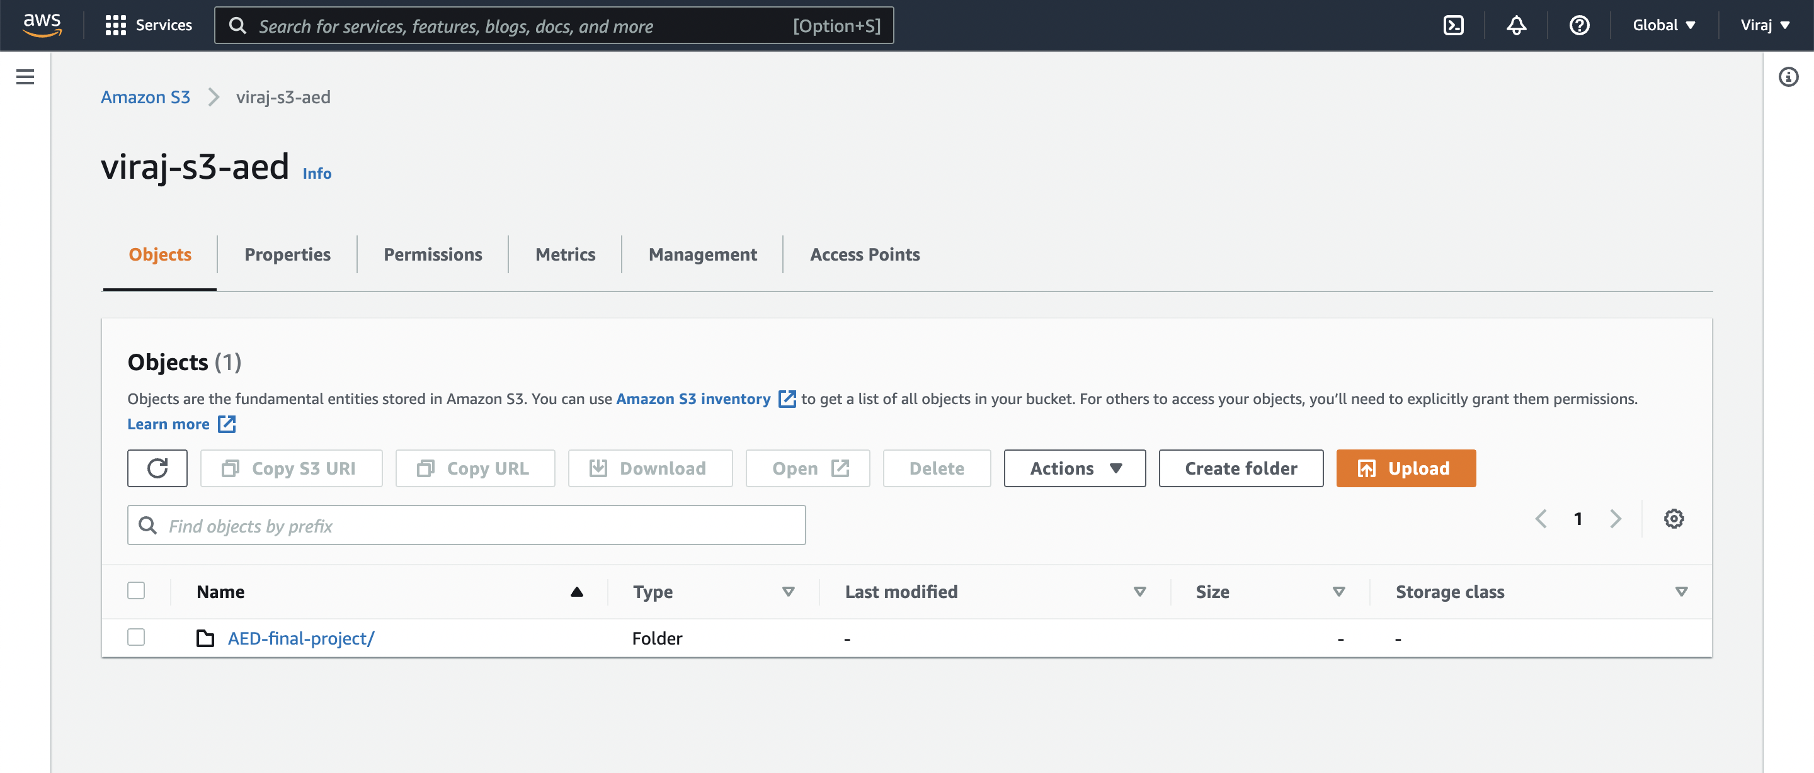
SCREENSHOTS
AWS S3 Bucket for CI/CD

Slide 22
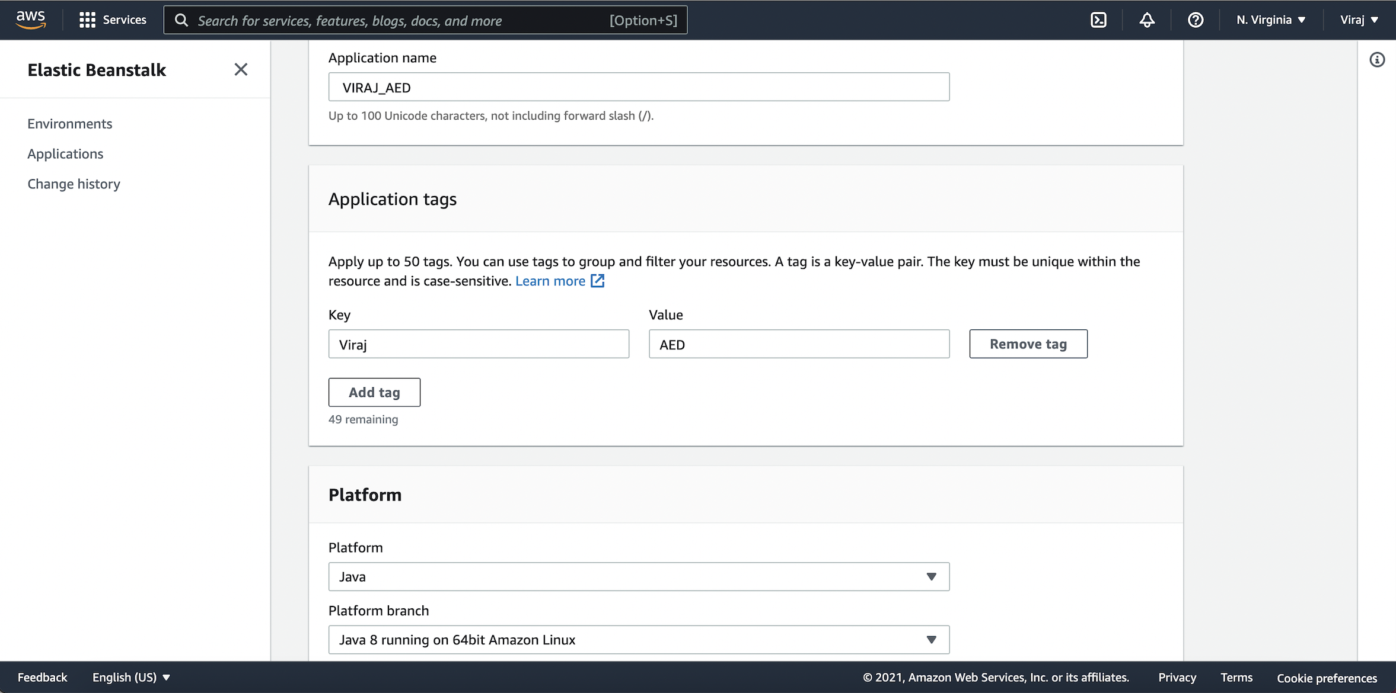
SCREENSHOTS
AWS S3 Bucket for CI/CD

Slide 23
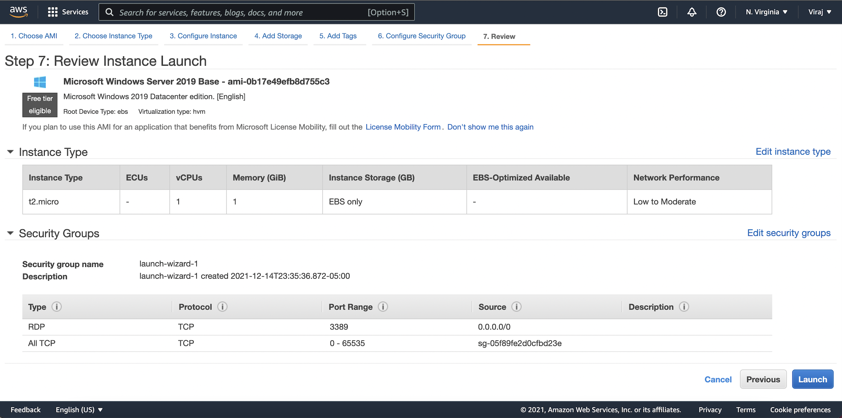
SCREENSHOTS
AWS S3 Bucket for CI/CD

Slide 24
LEARNING OUTCOMES
Ecosystem model
Customer and Business requirement gathering
Time Completion Strategies, Analysis and estimation for each task
Testing Types and Methods, Unit, Integration and Black Box Testing
Advance java Concepts such as multi threading, etc.
Defects and Bug tracking along with Debugging
Scalability Planning of Project
Leveraging Cloud Platforms Like AWS, S3 Bucket Services
CI/CD on Cloud Platforms such as AWS

Slide 25
THANK YOU!

